Slide 1

THE ONE-TECH COMPAY PEOPLE ANALYTICS
SEUN DADA

Slide 2
OUTLINE
Project Overview
Introduction
Methodologies
Results
Findings
Conclusion

Slide 3

PROJECT OVERVIEW
The Employee company's employee data. By leveraging MySQL for data processing and Power BI for visualization, this project aims to help the company make informed decisions regarding workforce management, performance, and retention Workforce Analytics project is designed to provide insights into the.

Slide 4

INTRODUCTION
In this study, the information provides an overview of the Employee Workforce Analytics project, including the data set, tools, and steps for analysis. The project aims to help the company understand its employee workforce better, identify trends, and make data-driven decisions to improve HR strategies.

Slide 5
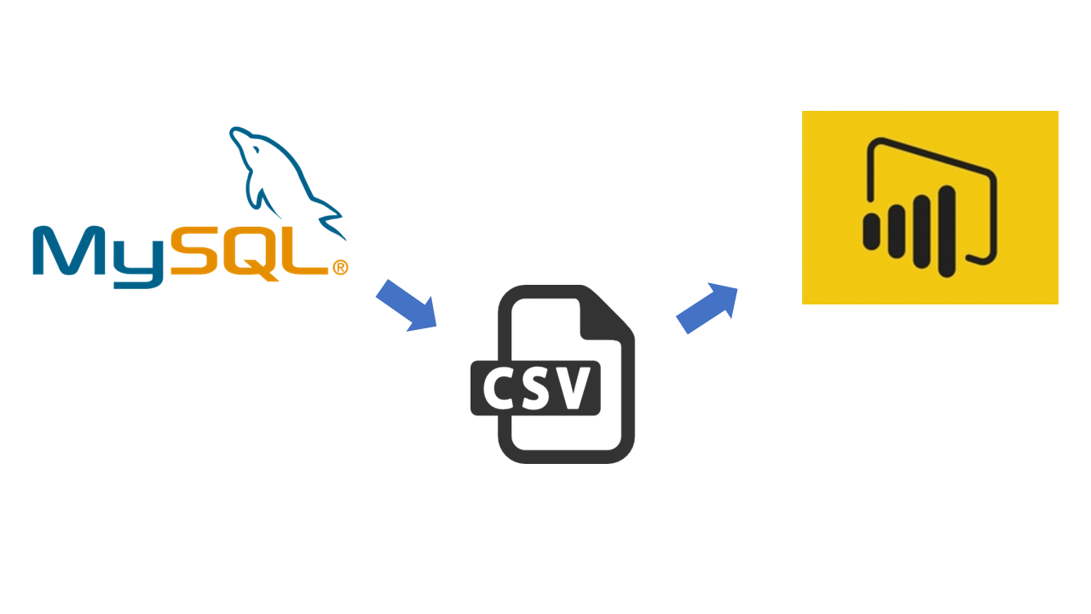
METHODOLOGY
MySQL: This relational database management system will be used to store, manage, and query the employee data.
Power BI: This business intelligence tool will be employed for data visualization, creating insightful reports, and dashboards.

Slide 6
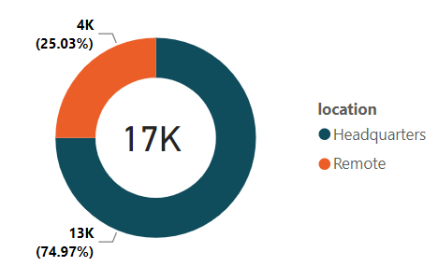
RESULTS
The result from the analysis shows the number of employees that work from the Headquarters to the ones working remotely.

Slide 7
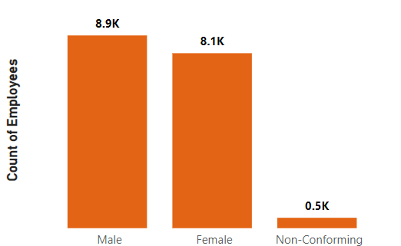
RESULTS
The results shows the gender breakdown count, in which it shows the gender balance between male and female, with the male slightly higher in number.

Slide 8
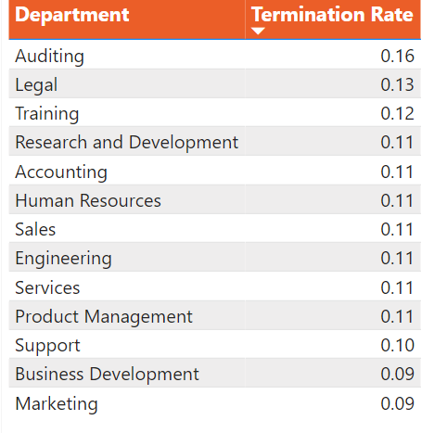
RESULTS
The results shows the gender breakdown count, in which it shows the gender balance between male and female, with the male slightly higher in number.

Slide 9
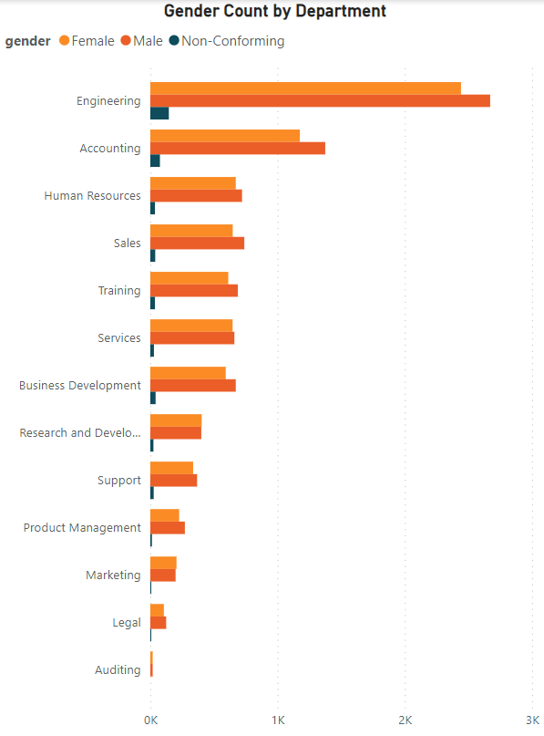
RESULTS
The results shows the gender breakdown count, in which it shows the gender balance between male and female, with the male slightly higher in number.

Slide 10

FINDINGS
Gender Breakdown: The workforce is categorized into three gender categories: Male, Female, and Non-Conforming. Males make up the largest proportion, while the Non-Conforming group represents a relatively small percentage of the workforce.
Race/Ethnicity Diversity: There are about seven different ethnicities represented in the employee population, with the majority being White. This suggests that there may be room for improvement in increasing diversity and inclusion.
Age Distribution: The age distribution of employees is highest within the 35-44 age range, indicating a significant portion of the workforce falls within this bracket.
Location Distribution: Approximately 75% of employees work at the headquarters, which suggests a concentration of the workforce in a specific location. This may have implications for resource allocation and remote work policies.
Average Tenure of Terminated Employees: The average length of employment for terminated employees is 10 years, which may warrant further investigation into the reasons for termination and the potential for employee retention efforts.

Slide 11

FINDINGS
Gender Balance in Departments: There appears to be a slight gender balance in each department, with males slightly outnumbering females by 2% on average. This suggests a generally equitable distribution of gender within various departments.
Turnover Rate by Department: The Auditing department has the highest turnover rate, which may necessitate HR intervention to understand and address the causes of turnover in this specific department.
Location of Employees: Most employees reside in Ohio, while the lowest number live in Kentucky. This information could be important for considering regional factors and workforce planning.
Employee Count Trend: Over time, there has been an increase in the employee count between 2000 and 2020. This growth may be indicative of the company's expansion or success during this period.

Slide 12

CONCLUSION
The analysis brings to light essential insights about the employee workforce, encompassing aspects such as gender distribution, departmental dynamics, and historical growth trends.
These findings provide a valuable foundation for enhancing HR strategies and fostering inclusivity and retention.

Slide 13


Like and Share
If you learnt something
Follow for more information on Business Analytics, HR Analytics, Dashboarding and more

